Slide 1
GUI Currency Converter
Ansley Hendrix

Slide 2
What does it do?
This graphical user interface works to make currency conversions by entering the two currencies the user is converting as well as the currency rate between the two.

Slide 3
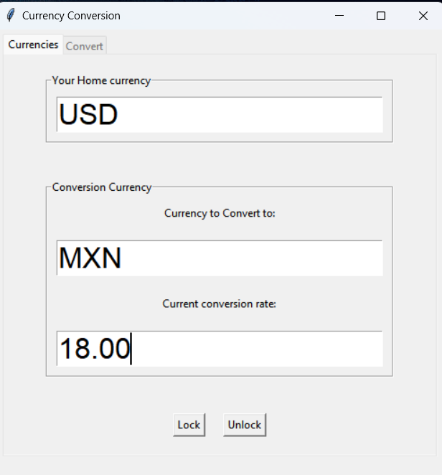
Enter name of currency you will be converting from
Enter name of currency you want to convert to:
Enter conversion rate between the two currencies

Slide 4
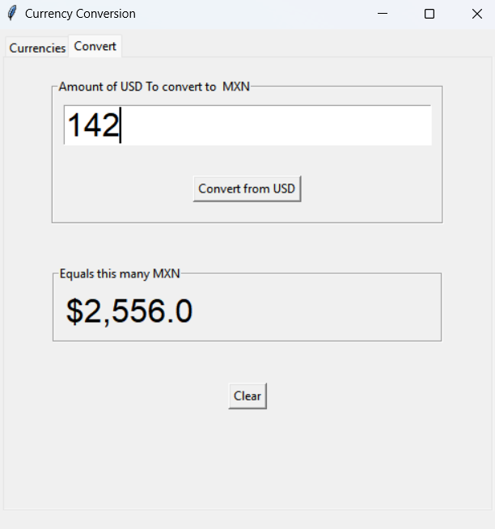
Enter Amount to convert
Receive converted amount

Slide 5
THANK YOU

